Slide 1

Key Stage Two Morning Prayer
O Jesus,
through the most pure heart of Mary,
I offer you all my prayers,
thoughts, works and sufferings of this day
for all the intentions of your most Sacred heart.
Amen

Slide 2
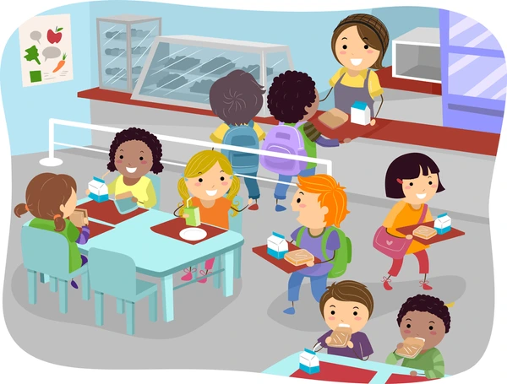
Key Stage Two Grace Before Meals
Bless us, O Lord, and these your gifts
which we are about to receive from your bounty.
Through Christ our Lord.
Amen

Slide 3

Key Stage Two Grace After Meals
We give you thanks, Almighty God,
for all your benefits,
who live and reign, world without end.
Amen

Slide 4

Key Stage Two Home Time Prayer
Lord Jesus Christ,
As we come to the end of this school day,
Help us to reflect and to pray:
For the difficulties I have known, I ask for your help.
For the blessings I have received; I thank you.
May I seek to be an instrument of your peace in my home today.
Each day is a gift.
May I look forward to a new start tomorrow.
May the journey of my life be an experience of your love,
your compassion,
your forgiveness
and your peace
Amen.

Slide 5

Prayer of the Month for September:
St. Joseph’s School Prayer
Loving Jesus
You teach us that “With God, all things are possible.” Help us to do our very best each day.
Thank you for shining your light in our school, on our teachers, our friends and our families.
Help us to follow your example and trust you every day.
Give us courage through the Holy Spirit to live like you, trust you, follow your example and show your love to others.
Amen.

Slide 6
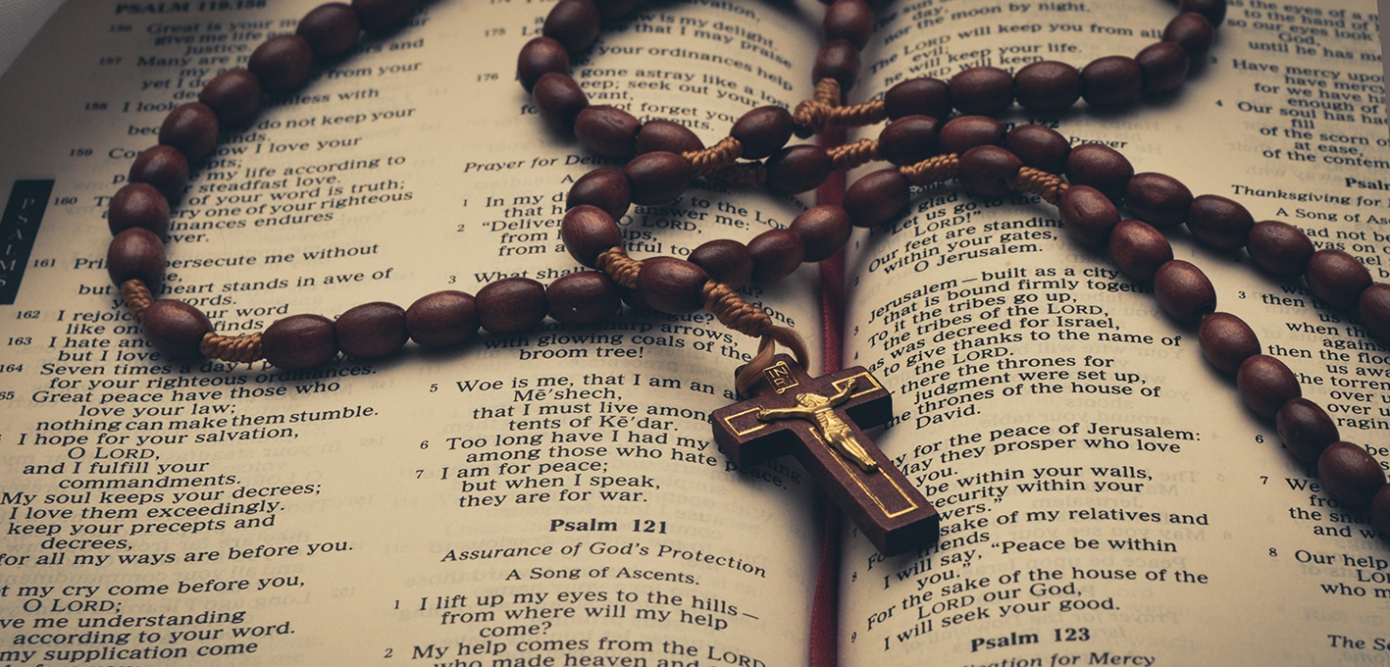
Prayer of the Month for October:
The Rosary
Our Father x 1
Hail Mary x 10
Glory Be x 1
Leader: Pray for us, O holy Mother of God.
Response: That we may be made worthy of the promises of Christ.
Leader: Let us pray.
Response: O God, whose only-begotten Son,
By his life, death and resurrection, has purchased for us the rewards of eternal life,
Grant, we beseech thee, that meditating on these mysteries of the most holy Rosary of the Blessed Virgin Mary,
We may imitate what they contain and obtain what they promise,
Through the same Christ our Lord.
Amen

Slide 7

Prayer of the Month for November:
Prayer to the Guardian Angel
Angel of God, my guardian dear,
to whom God's love commits me here,
ever this day be at my side,
to light and guard, to rule and guide.
Amen.

Slide 8

Prayer of the Month for December:
The Act of Hope
My God, I hope in you,
for grace and for glory,
because of your promises,
your mercy and power.
Amen.

Slide 9

Prayer of the Month for January:
The Act of Faith
My God, I believe in you
and all your Church teaches,
because you have said it
and your word is true.
Amen.

Slide 10
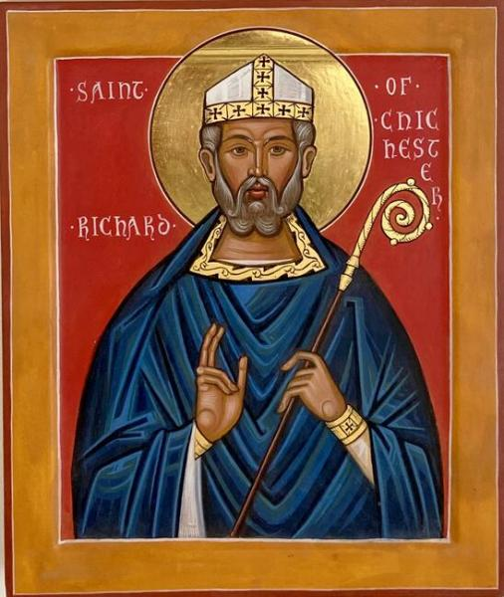
Prayer of the Month for February:
Prayer of St. Richard of Chichester
Day by day, O dear Lord,
three things I pray:
to see you more clearly,
love you more dearly,
follow you more nearly,
day by day,
by day, by day.
Amen.

Slide 11
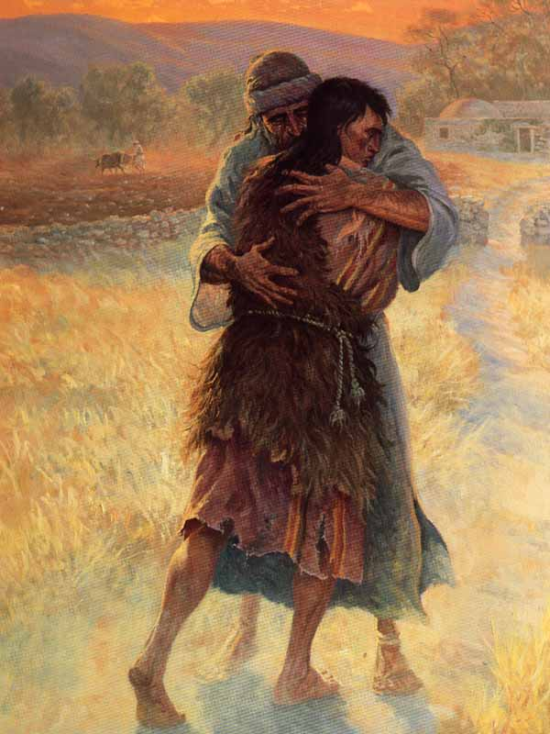
Prayer of the Month for March:
The Act of Contrition
O my God,
because you are so good,
I am very sorry that I have sinned against you,
and with the help of your grace
I will not sin again

Slide 12
Prayer of the Month for April:
The Apostles Creed
I believe in God, the Father almighty;
creator of heaven and earth;
and in Jesus Christ, his only Son, our Lord,
who was conceived by the Holy Spirit,
Born of the Virgin Mary,
Suffered under Pontius Pilate,
was crucified, died and was buried;
he descended into hell;
on the third day he rose again from the dead; he ascended into heaven,
and is seated at the right hand of God the Father almighty;
From there he will come to judge the living and the dead.
I believe in the Holy Spirit,
the holy catholic Church,
the communion of saints,
the forgiveness of sins,
the resurrection of the body,
and life everlasting.
Amen

Slide 13
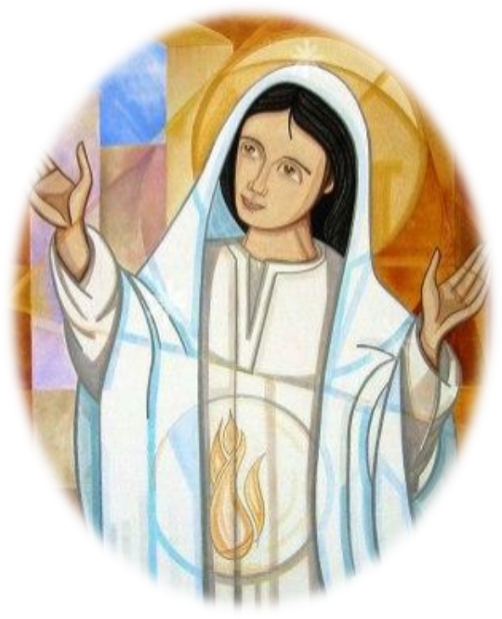
Prayer of the Month for May:
The Magnificat
My soul glorifies the Lord,
My spirit rejoices in God, my Saviour.
He looks on his servant in her loneliness;
henceforth all ages will call me blessed.
The Almighty works marvels for me.
Holy his name! His mercy is from age to age, on those who fear him.
He puts forth his arm in strength and scatters the proud-hearted.
He casts the mighty from their thrones
and raises the lowly.
He fills the starving with good things,
sends the rich away empty.
He protects Israel, his servant,
remembering his mercy,
the mercy promised to our fathers,
to Abraham and his sons for ever.
Amen.

Slide 14

Prayer of the Month for June:
Prayer to the Holy Spirit
Come, Holy Spirit,
fill the hearts of your faithful,
and kindle in them the fire of your love.
Send forth your Spirit and they shall be created.
And you shall renew the face of the earth.
O God, who has taught the hearts of the faithful
by the light of the Holy Spirit,
grant that by the gift of that same Spirit
we may be always truly wise
and ever rejoice in his consolation.
Amen.

Slide 15
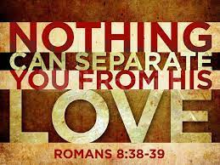
Prayer of the Month for July:
The Act of Love
My God, because you are so good,
I love you with all my heart,
And for your sake,
I love my neighbour as myself.
Amen.

