Slide 1


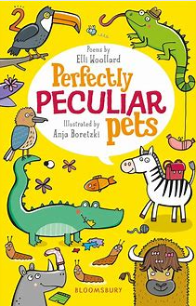

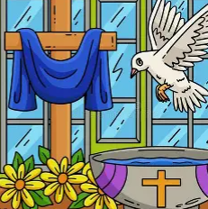
Year Two
Summer 2026
Welcome back! We hope that you have had a wonderful break and are ready for a term full of learning and fun!
Good to know...
English
When do we need Fluency Books, Reading Logs and Home Spelling Books?
Our focus text for the term are:
Emily Brown and the thing
The Villains
We will be looking at poems about ‘Peculiar Pets’ and writing our own poems
Fluency books – need to be completed each night. They need to come to school on a Friday, so that they can be marked and the following week’s Fluency questions can be stuck in.
Reading Books and logs –need to come to school everyday. Reading books will be changed on a Monday. Please sign your child’s log each time they read.
Home spelling books – need to come to school on Thursday’s. We complete our spelling test on a Thursday and then stick in our new spellings.
Maths
Maths
In maths we will continue to become secure in addition of subtraction of 2digit numbers.
We will learn about fractions, time, position and direction.
In mental maths we will become increasingly confident in recalling our x2,x5, and x 10 tables.
PE Kit
For the first half-term, our PE lessons will be on Wednesdays and Fridays. Please remove earrings at home on PE days.
Snacks and Water Bottles
RE
In year 2 Fruit is provided in the morning or the children may bring a healthy snack. Please bring a water bottle every day.
We begin the term learning about the season of Easter.
We will learn about what happened at Pentecost.
We will look at sacraments and special celebrations.
.

Slide 2








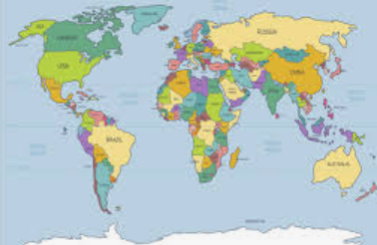
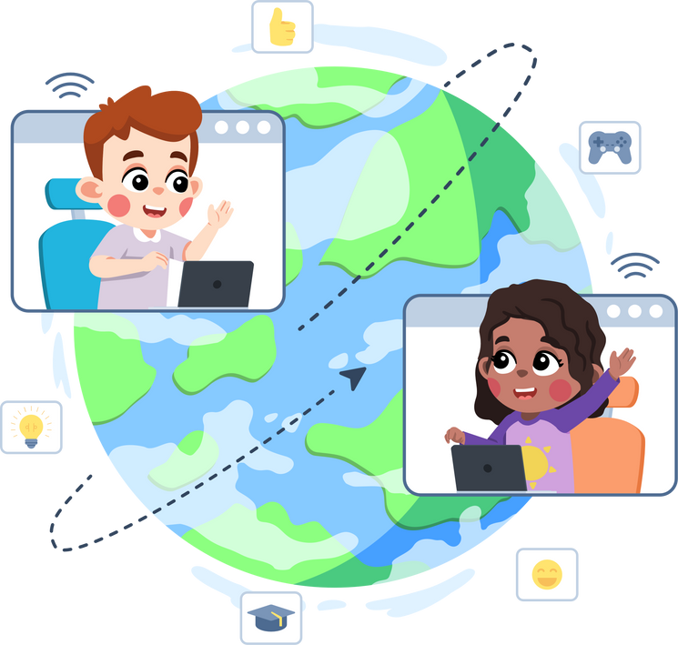
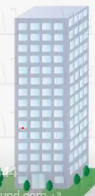




Other Subjects
History
We will be learning all about The Monarchy
Geography
How can I support my child at home?
We will be learning about different kinds of settlements – Cities, towns and villages.
Homework
PE
Reading - please encourage your child to read their book at home for at least 15 minutes every day and to write a comment in their reading log.
Fluency - the children will have 5 maths fluency questions to complete per day. They will need to complete them at home each night. These should take around 5 minutes to complete.
Spelling - practise the weekly spelling words with your child in a range of different ways.
RE Homework Projects - Once per half-term, there will be a creative RE homework project to complete with your child.
We will be learning how to stay fit and healthy through our units on multiskills and athletics.
Computing
We will be learning to ask questions and represent data. We will be looking at Coding.
Science
Year 2 will be learning about Living things and the different places that they live,.
Art
We will be studying a famous architect and making models.
Catholic Life
Encourage your child to spend time in prayer and reflection at home. Attend Sunday Mass with them whenever possible.
Design and Technology
We will be learning about healthy foods and making some of our own.
Music
Educational Visits
We will be exploring timbre, texture and tempo
  Summer Term
  We will be going to Tittesworth Reservoir on Friday 1st May.
  We will be going to Liverpool Cathedral on Thursday 25th June.
  We will be going to Twycross Zoo on Tuesday 7th July.
PSHE
We will be continuing with our ‘Jigsaw learning’, where we will thinking about our dreams, goals and aspirations.

