Slide 1



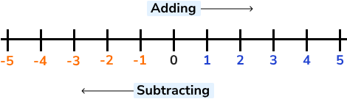
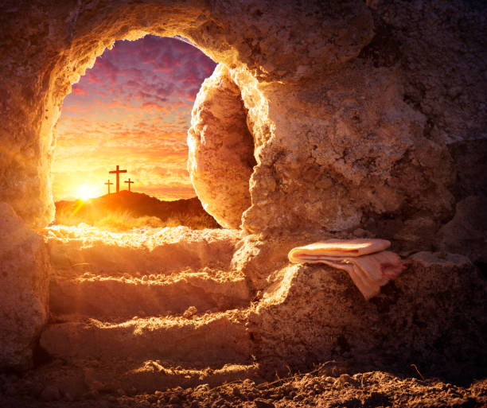
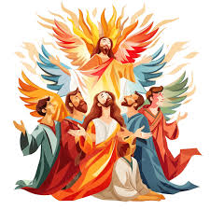

Year Five
Summer 2026
We hope that you have had a wonderful Easter break and are ready for another term full of learning and fun at St. Joseph’s!
Good to know...
English
A Uniform Reminder…
We begin by continuing with Street Child from last half term.
We also study The Tempest, a play by William Shakespeare.
Throughout the term, we will be doing a lot of SPaG work, recapping punctuation and grammar and sentence construction.
Please ensure your child attends school in their full school uniform each day. This includes a tie and sensible school shoes, not trainers.
PE Kit
Year 5 will have their PE lessons on a Wednesday and Friday during Summer term. It is really important that children have their PE kit in school for PE lessons.
Maths
When do we need Fluency Books, Reading Logs and Home Spelling Books?
In maths, we focus on geometry, including properties of shapes and position and direction.
We then revisit decimals, recapping how to add and subtract them as well as learning to multiply decimals by 10, 100 and 1,000.
Finally, we look at negative numbers, converting units and volume.
Fluency books - everyday. The children mark their previous day’s fluency homework and write their four new questions.
Reading logs - Children should write their comments, and hand their logs in on a Monday and Thursday to be signed.
Home spelling books – Fridays. Children will both have their dictation and receive their new spellings on this day.
RE
Snacks and Water Bottles
We begin the term in the liturgical season of Easter, a joyous time where we celebrate the Resurrection of Jesus. We follow this with the feast of Pentecost.
In Summer 2, we learn about the Work of the Apostles as well as the Sacraments of Holy Orders and Marriage.
Children may bring a healthy snack for break time.
As we move in to warmer weather, children must have a water bottle in school each day. A reminder that this should contain water only.

Slide 2



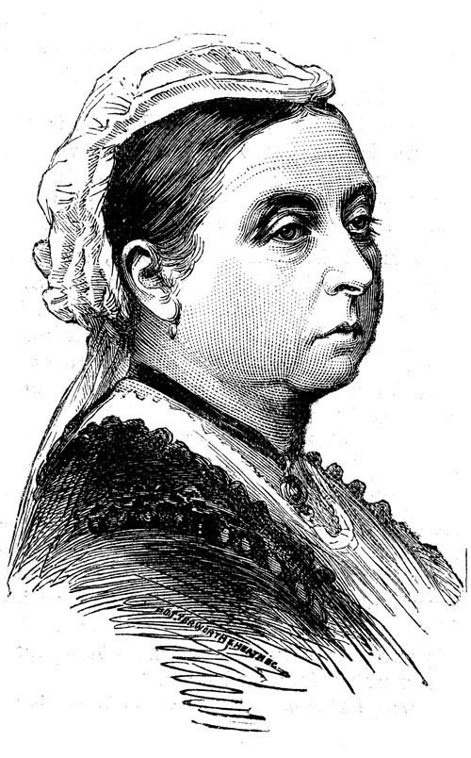





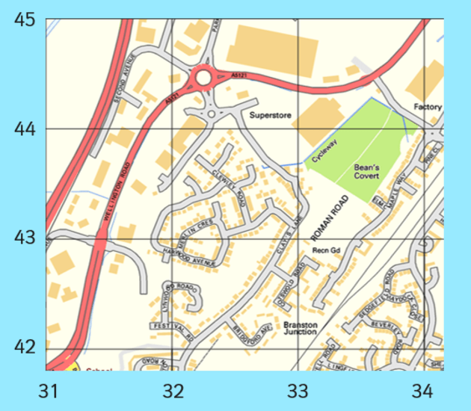
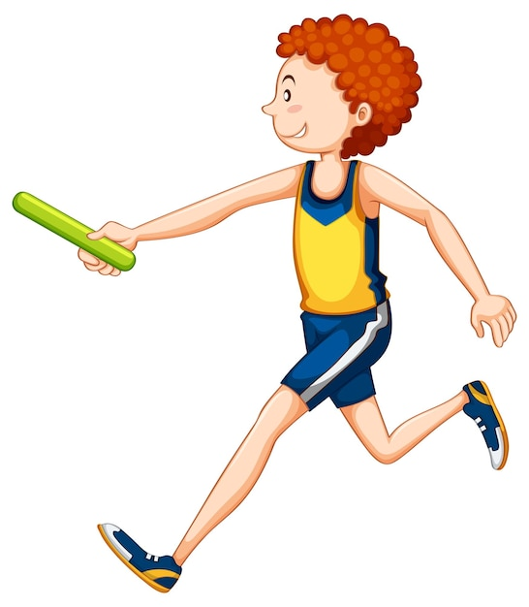

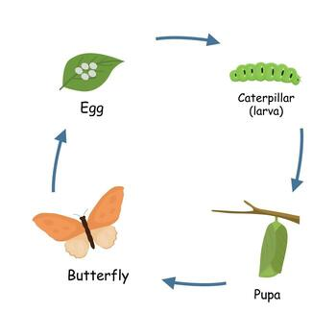


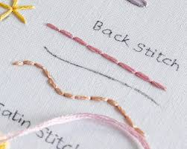




Other Subjects
History
We will be learning about the Victorians!
Geography
How can I support my child at home?
Our work will focus on creating maps and fieldwork, culminating in our Peak District Visit.
Homework
PE
Reading - please encourage your child to read their book at home for at least 15 minutes every day and to write a comment in their reading log.
Fluency - the children will have 4 maths fluency questions to complete per day. They will write these into their fluency book to practise their number formation and will need to complete them at home before the start of the next school day. These should take around 5 minutes to complete.
Spelling - practise the weekly spelling words with your child in a range of different ways.
RE Homework Projects - Once per half-term, there will be a creative RE homework project to complete with your child.
We will be doing athletics and hockey.
Computing
We will be learning about coding and word processing.
Science
Year 5 will be focusing on Living Things and Animals, including Humans
Art
We will be learning how to be fashion designers!
Design and Technology
Times Table Rockstars
We will be sewing in textiles, learning different stitches to make a product.
Play Times Table Rockstars at
least four times a week to maintain their recall of times table facts. Your child’s login is in their reading log.
Music
Catholic Life
Children will develop keyboard skills and rehearse for and perform in the Summer Concert.
Encourage your child to spend time in prayer and reflection at home. Attend Sunday Mass with them whenever possible.
French
Educational Visits
Year 5 will continue to learn French verbs and describe our families in French.
  Day visit to Stanley Head for outdoor adventures (05.05.2026)
  Visit to the Peak District, improving our directional and map reading skills (22.06.2026)
  Please consent and pay for both of these visits on Arbor as soon as possible. Thank you.
PSHE
We will be completing Jigsaw pieces about being healthy and our relationships, especially online.

